Slide 1
Transition Probability of Success from Phase II to Phase III Trials: Adjusting for Selection Bias
Speaker: Fangfang Jiang
Mentors: Mitchell Thomann, Zhiguang (Caleb) Huo
Date: December 15, 2025

Slide 2

Outline
Introduction
Background
Motivation
Research Objectives
Overview of Bias Adjustment Methods
Real-Data Analysis
Simulation Study

Slide 3




Introduction
To change the illustration:
Choose a scene illustration from our Brand Hub and download it as an SVG in the appropriate color: Go to the illustration library ↗
Click on the existing illustration.
Open the menu ‘Graphics Format’.
Choose ‘Change Graphic’ and then the corresponding source where the illustration is located.
Now the illustration has been loaded into the placeholder.
Why does selection bias matter when transitioning from Phase II to Phase III trials?

Slide 4



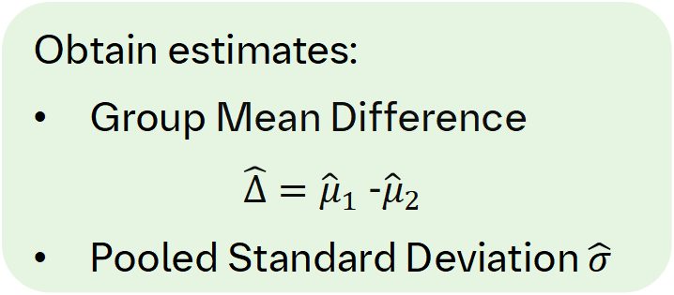


Background
Phase II
$$m_{1}=m$$
Treatment Group
$${\hat{μ}}_{1}$$
Obtain estimates:
Group Mean Difference
$\hat{Δ}={\hat{μ}}_{1}$-${\hat{μ}}_{2}$
Pooled Standard Deviation $\hat{σ}$
Patient Enrollment
Placebo Group
$$m_{2}=m$$
$${\hat{μ}}_{2}$$
Note: one can use statistical modeling to obtain the estimates, but in our project, we simply use the summary statistics.
“No-go” Decision: stop at Phase II
No
If $\hat{Δ}>Δ_{PD}$?
Phase III
“Go” Decision: launch a Phase III Trial
Yes
Patient Enrollment
* $Δ_{PD}$ is a predefined clinical threshold.

Slide 5
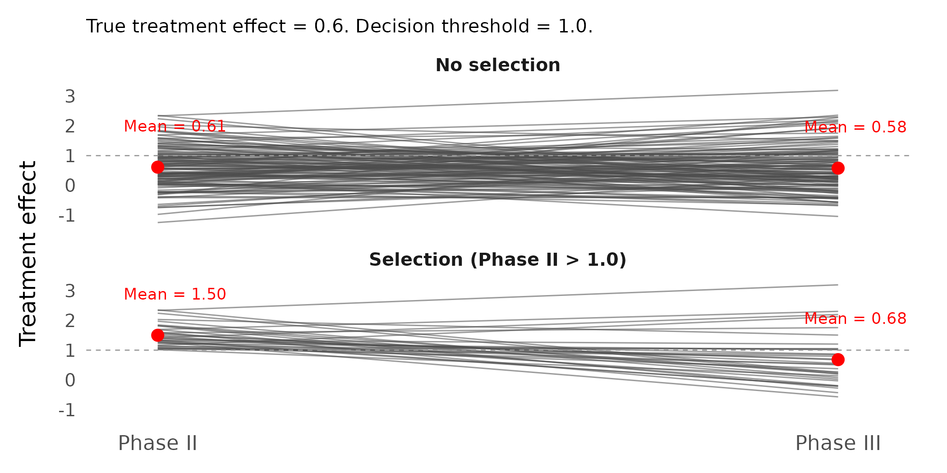
Motivation
Probability of Success (PoS): the predictive probability of achieving a quantitative outcome in a clinical trial, i.e., statistical significance in Phase III.
Phase II results are routinely used to inform Phase III go/no-go decisions and Phase III sample size planning.
However, the observed Phase II treatment effect is usually subject to selection bias because only "successful" Phase II trials are utilized.
Relying on inflated Phase II estimates may lead to:
Underpowered Phase III trials (due to larger sample size needed)
Lower-than-expected treatment effect in Phase III trials, i.e., higher expectation on Phase III PoS
Notes:
Why Predictive probability? – Because we typically use Bayesian models and it‘s based on some data that we have, like our Phase II data, external data, or something else. We are predicting the likelihood of succes of the Phase III trial.

Slide 6
Research Objectives
Research Question:
How well do existing bias adjustment methods estimate Phase III PoS from Phase II trials, accounting for selection bias?
Research Objectives:
Apply bias adjustment methods from Chuang-Stein & Kirby [1].
Discount potential bias in Phase II studies and obtain less biased treatment effect estimates.
Assess competitive landscape using real Phase II and Phase III data.
Quantify how those bias adjustment methods move observed Phase II effects toward more realistic values.
Develop a simulation study for Phase II to Phase III transition.
Assess PoS under multiple bias adjustment methods.
Provide guidance for future PoS projects.

Slide 7


Bias Adjustment Methods
To change the illustration:
Choose a standalone illustration from our Brand Hub and download it as an SVG in the appropriate color: Go to the illustration library ↗
Click on the existing illustration.
Open the menu ‘Graphics Format’.
Choose ‘Change Graphic’ and then the corresponding source where the illustration is located.
Now the illustration has been loaded into the placeholder.

Slide 8

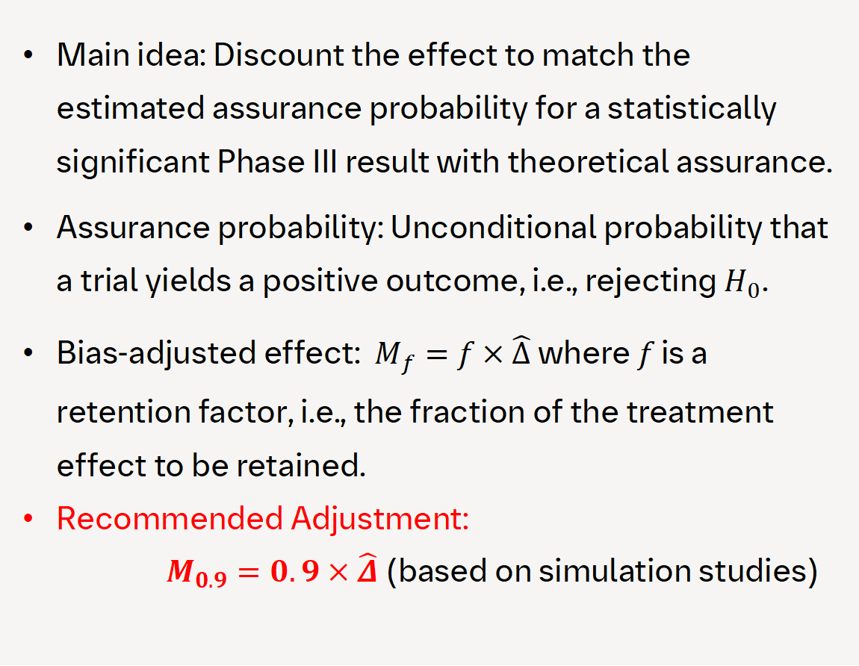
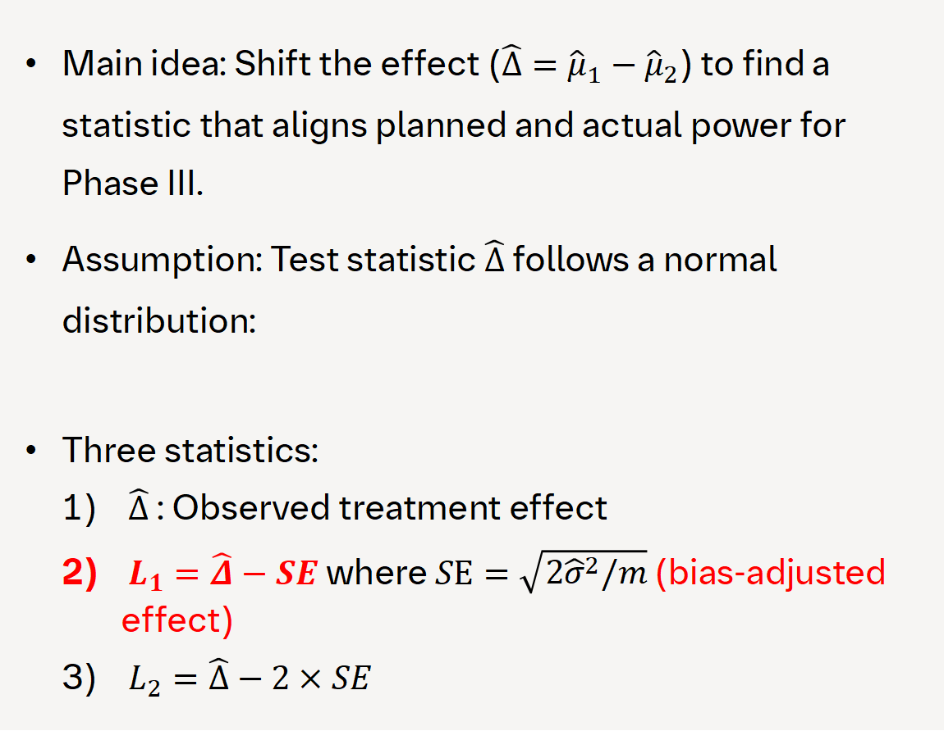
Shifting and Multiplicative Methods
Method 1: Shifting Method
Method 2: Multiplicative Method
Main idea: Shift the effect ($\hat{Δ}={\hat{μ}}_{1}−{\hat{μ}}_{2}$) to find a statistic that aligns planned and actual power for Phase III.
Assumption: Test statistic $\hat{Δ}$ follows a normal distribution:
Three statistics:
$\hat{Δ}$: Observed treatment effect
$L_{1}=\hat{Δ}−SE$ where $SE=\sqrt{2{\hat{σ}}^{2}/m}$ (bias-adjusted effect)
$L_{2}=\hat{Δ}−2×SE$
Main idea: Discount the effect to match the estimated assurance probability for a statistically significant Phase III result with theoretical assurance.
Assurance probability: Unconditional probability that a trial yields a positive outcome, i.e., rejecting $H_{0}$.
Bias-adjusted effect: $M_{f}=f×\hat{Δ}$ where $f$ is a retention factor, i.e., the fraction of the treatment effect to be retained.
Recommended Adjustment:
$M_{0.9}=0.9×\hat{Δ}$ (based on simulation studies)
$$\hat{Δ}\sim N\left(Δ,\sqrt{\frac{2σ^{2}}{m}}\right)$$

Slide 9
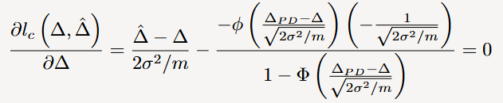
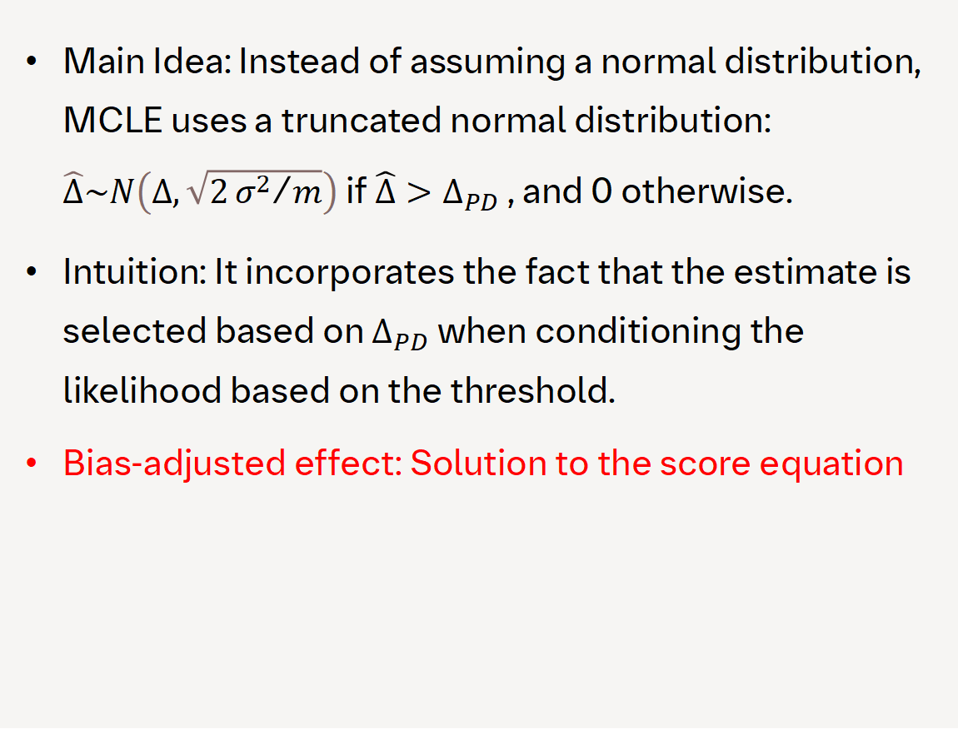
Bayesian and Likelihood-Based Methods
Method 4: Maximum Conditional Likelihood Estimator (MCLE)
Method 3: Informative Prior Method
Main idea: Incorporate historical data into the current study using a Bayesian informative prior to get the observed treatment effect.​
Historical data source: Previous Phase II/III trials in similar populations for the same endpoint.​
Intuition: Borrow strength from prior evidence to reduce uncertainty in estimates.​
Bias-adjusted effect: Posterior mean​
Main Idea: Instead of assuming a normal distribution, MCLE uses a truncated normal distribution: $\hat{Δ}\sim N\left(Δ,\sqrt{2{σ^{2}}/m}\right)$ if $\hat{Δ}>Δ_{PD}$, and 0 otherwise.
Intuition: It incorporates the fact that the estimate is selected based on $Δ_{PD}$when conditioning the likelihood based on the threshold.
Bias-adjusted effect: Solution to the score equation
Notes:
The intuition is that in our project, the indication historically shows large gaps between Phase II and Phase III performance, so incorporating past evidence helps us capture the indication effect rather than attributing everything to the compound.
We try to look for compounds that have similar mechanisms of action and try to identify compounds.
Phase III trials historically have a very low success rate, even when Phase II results look promising. So when we incorporate data into the model, the intention is to capture what may be an indication effect rather than a compund-specific effect. In other word, this disease area is inherently difficult.
There might be more of an indication effect rather than a compund. Causes: unclear disease mechanism

Slide 10

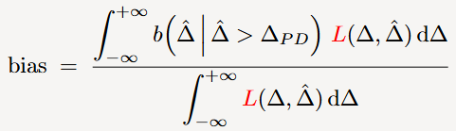
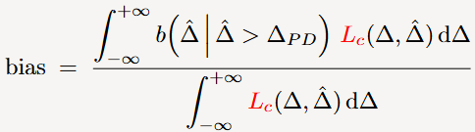
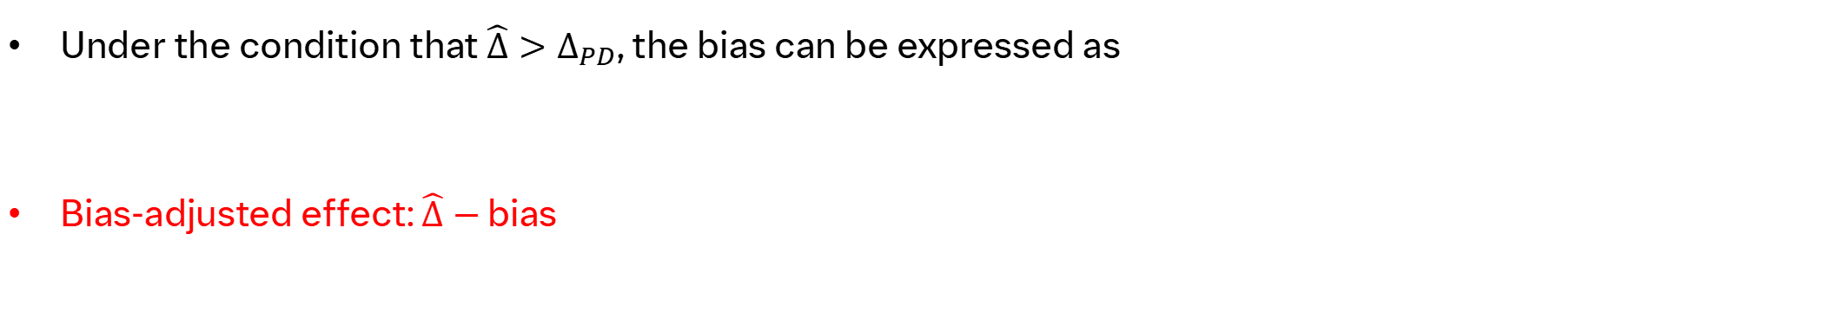
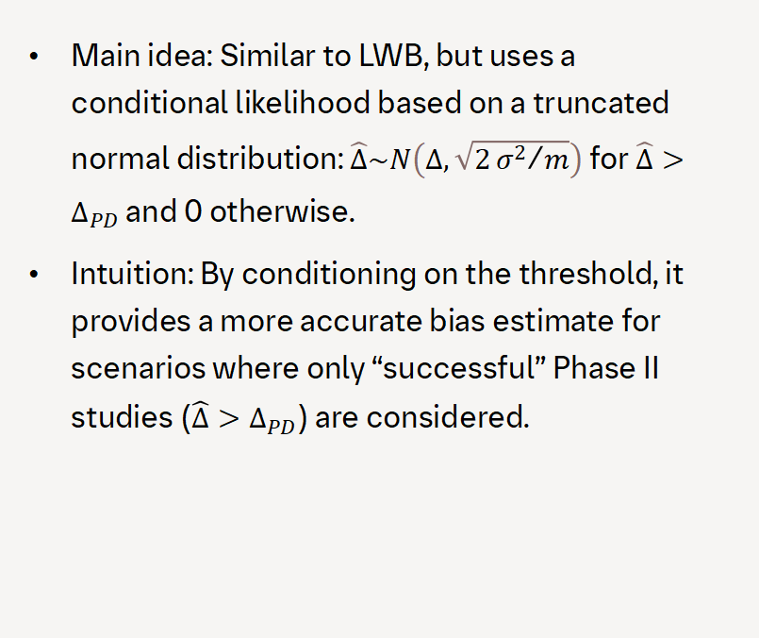
Bias Subtraction Methods
Under the condition that $\hat{Δ}>Δ_{PD}$, the bias can be expressed as
Bias-adjusted effect: $\hat{Δ}−$ bias
.
Method 6: Likelihood Weighted Bias (LWB)
Method 7: Conditional Likelihood Weighted Bias (CLWB)
Method 5: Percentile Bias (PB)
Main idea: This method uses a Bayesian framework with a vague prior and computes the bias as a percentile (e.g., 20th percentile) of the posterior distribution.
Intuition: Use a percentile to reflect uncertainty and subtract a conservative estimate of the bias.
Main idea: This method calculates the expected bias under the normal likelihood, weighted by the likelihood function.
Intuition: It integrates over possible true effects, weighting by how plausible they are given the observed data.
Main idea: Similar to LWB, but uses a conditional likelihood based on a truncated normal distribution: $\hat{Δ}\sim N\left(Δ,\sqrt{2{σ^{2}}/m}\right)$ for $\hat{Δ}>Δ_{PD}$ and 0 otherwise.
Intuition: By conditioning on the threshold, it provides a more accurate bias estimate for scenarios where only “successful” Phase II studies ($\hat{Δ}>Δ_{PD}$) are considered.
Notes:
The likelihood: one is normal, the other is truncated normal.

Slide 11

Real-Data Analysis
To change the illustration:
Choose a standalone illustration from our Brand Hub and download it as an SVG in the appropriate color: Go to the illustration library ↗
Click on the existing illustration.
Open the menu ‘Graphics Format’.
Choose ‘Change Graphic’ and then the corresponding source where the illustration is located.
Now the illustration has been loaded into the placeholder.

Slide 12


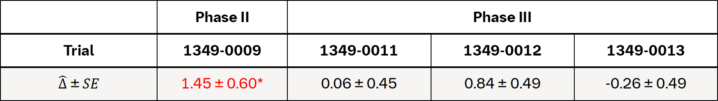
BI Phase II & Phase III Trials
 | Phase II | Phase III
Trial | 1349-0009 | 1349-0011 | 1349-0012 | 1349-0013
$\hat{Δ} \text{±} SE$ | 1.45 ± 0.60* | 0.06 ± 0.45 | 0.84 ± 0.49 | -0.26 ± 0.49
* The estimates were derived from a dose-response model based on the aggregated group-level data using MCP-Mod.
Phase II Trial: Proof-of-concept and dose-finding study of BI 425809 versus placebo in patients with schizophrenia, where primary endpoint was change from baseline to Week 12 in MCCB overall composite T-score.
Phase III Trials: Three studies evaluating the efficacy of BI 425809 (10 mg) in improving cognitive impairment in schizophrenia over 26 weeks compared with placebo using MCCB.
Results: The Phase II study showed a positive treatment effect (p-value < 0.05), but all three subsequent Phase III trials did not demonstrate a statistically significant treatment effect (p-values > 0.05).
Notes:
Phase II showed a significant effect, the three Phase III trials did not show the same thing. This discrepancy suggest the Phase II result may be influence by selection bias . The rationale for using bias adjustment methods in this case is to address potential inflation of the observed Phase II effect.

Slide 13
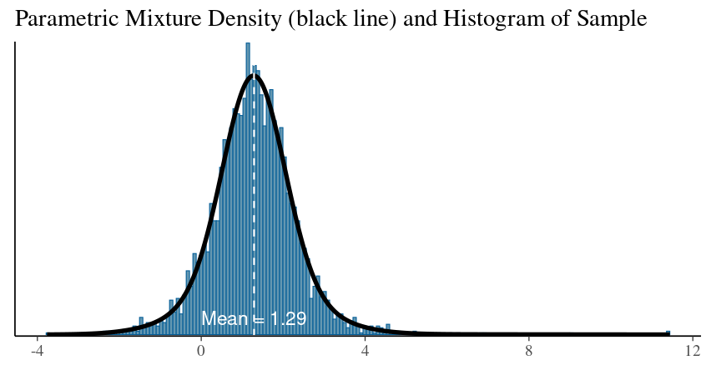
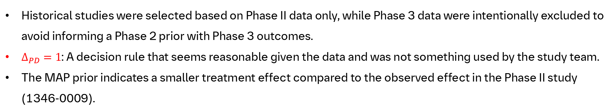
Meta-Analytic-Predictive (MAP) prior
Study | Phase | Mean | SE
1 | Ph2 | 0.7 | 1.78
2 | Ph2 | 1.14 | 1.82
3 | Ph2 | 1.3 | 1.00
4 | Ph2 | 1.5 | 1.00
5 | Ph3 (1346.11) | 0.06 | 0.45
6 | Ph3 (1346.12) | 0.84 | 0.49
7 | Ph3 (1346.13) | -0.26 | 0.49
8 | Ph3 | 0.6 | 0.41
9 | Ph3 | 0.6 | 0.43
Density of the MAP prior
Utilized as historical data
Historical studies were selected based on Phase II data only, while Phase 3 data were intentionally excluded to avoid informing a Phase 2 prior with Phase 3 outcomes.
$Δ_{PD}=1$: A decision rule that seems reasonable given the data and was not something used by the study team.
The MAP prior indicates a smaller treatment effect compared to the observed effect in the Phase II study (1346-0009).
Notes:
The go-decision threshold was an approximate value based on the data and the dose-response patterns we saw in this study. (be less definitive)

Slide 14
Result
Method | Without Historical Data | With Historical Data
Shifting Method | 0.857 | 0.907
0.9 Multiplicative Method | 1.307 | 1.251
Informative Prior Method | - | 1.390
MCLE | 0.936 | 1.012
PB Method | 0.496 | -
LWB Method | 1.147 | 1.152
CLWB Method | 1.356 | 1.317
All bias adjustment methods move estimates in the direction of the decision threshold $Δ_{PD}=1$, regardless of whether historical data is included .
Notes:
Because the PB method gives almost the same estimate regardless of the observed Phase II effect, we leave it out of the simulation study.
It’s doing what we would expect.
However, since we don’t know the truth, it is hard to get much takeaway from a single analysis.

Slide 15

Simulation Study
To change the illustration:
Choose a scene illustration from our Brand Hub and download it as an SVG in the appropriate color: Go to the illustration library ↗
Click on the existing illustration.
Open the menu ‘Graphics Format’.
Choose ‘Change Graphic’ and then the corresponding source where the illustration is located.
Now the illustration has been loaded into the placeholder.
Assessing bias adjustment methods through simulation.

Slide 16




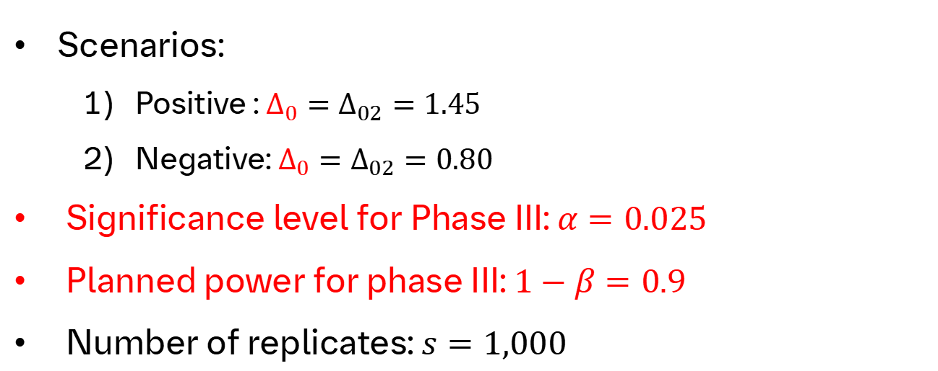


Simulation Design
True Phase II effect: $Δ_{02}$
True Phase III effect: $Δ_{0}$
Clinical Threshold: $Δ_{PD}=1$
SD: $σ=4.5$
Phase II sample size (per group): $m∈\left\{50,100\right\}$
Scenarios:
Positive : $Δ_{0}=Δ_{02}=1.45$
Negative: $Δ_{0}=Δ_{02}=0.80$
Significance level for Phase III: $α=0.025$
Planned power for phase III: $1−β=0.9$
Number of replicates: $s=1,000$
Select $Δ_{0}$, $Δ_{02}$, and $m$
Sample Phase II estimate: $\hat{Δ}\sim N(Δ_{02},\sqrt{2{σ^{2}}/m})$
Perform bias adjustment to obtain ${\hat{Δ}}_{adj}$
Launch Phase III if ${\hat{Δ}}_{adj}>Δ_{PD}$ and compute Phase III sample size $n$
Step 5
Step 1
Step 2
Step 3
Step 4
Sample Phase III estimate: ${\hat{Δ}}^{∗}\sim N\left(Δ_{0},\sqrt{2{σ^{2}}/n}\right)$ and test $H_{0}:Δ_{0}=0$
Evaluation
Notes:
Just say we cover the results for m=100 due to time.

Slide 17
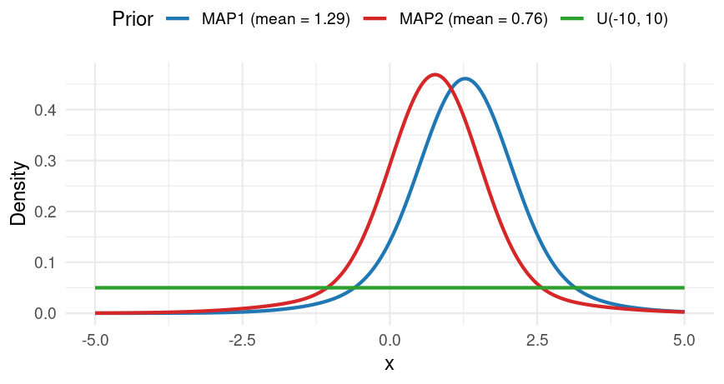
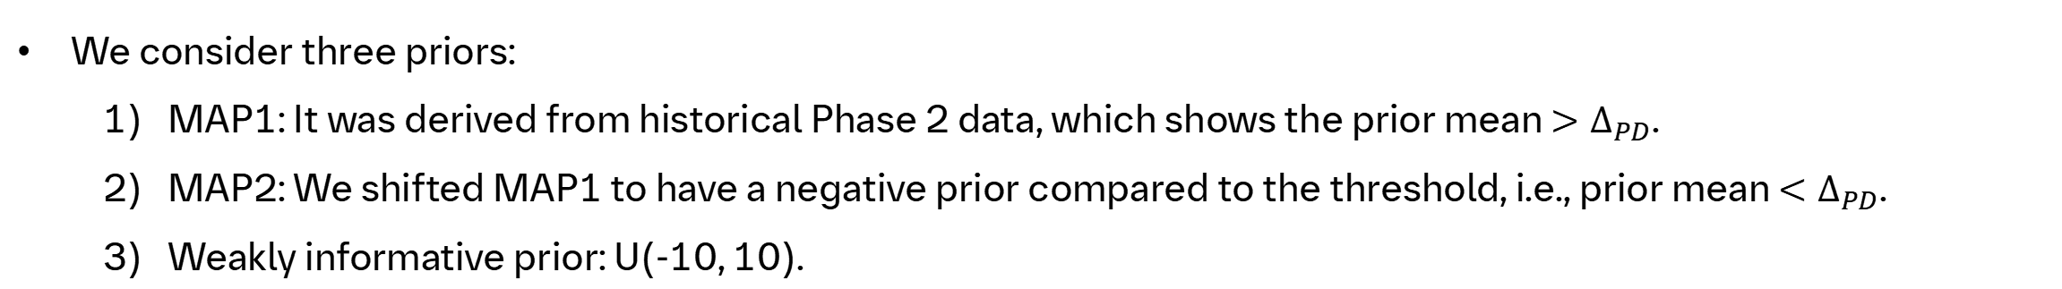
Simulation Design
We consider three priors:
MAP1: It was derived from historical Phase 2 data, which shows the prior mean ${>Δ}_{PD}$.
MAP2: We shifted MAP1 to have a negative prior compared to the threshold, i.e., prior mean ${<Δ}_{PD}$.
Weakly informative prior: U(-10, 10).
Notes:
We wanted to look at two cases, one where the historical data was positive, one where the historical data was negative compared to our thresholds.

Slide 18
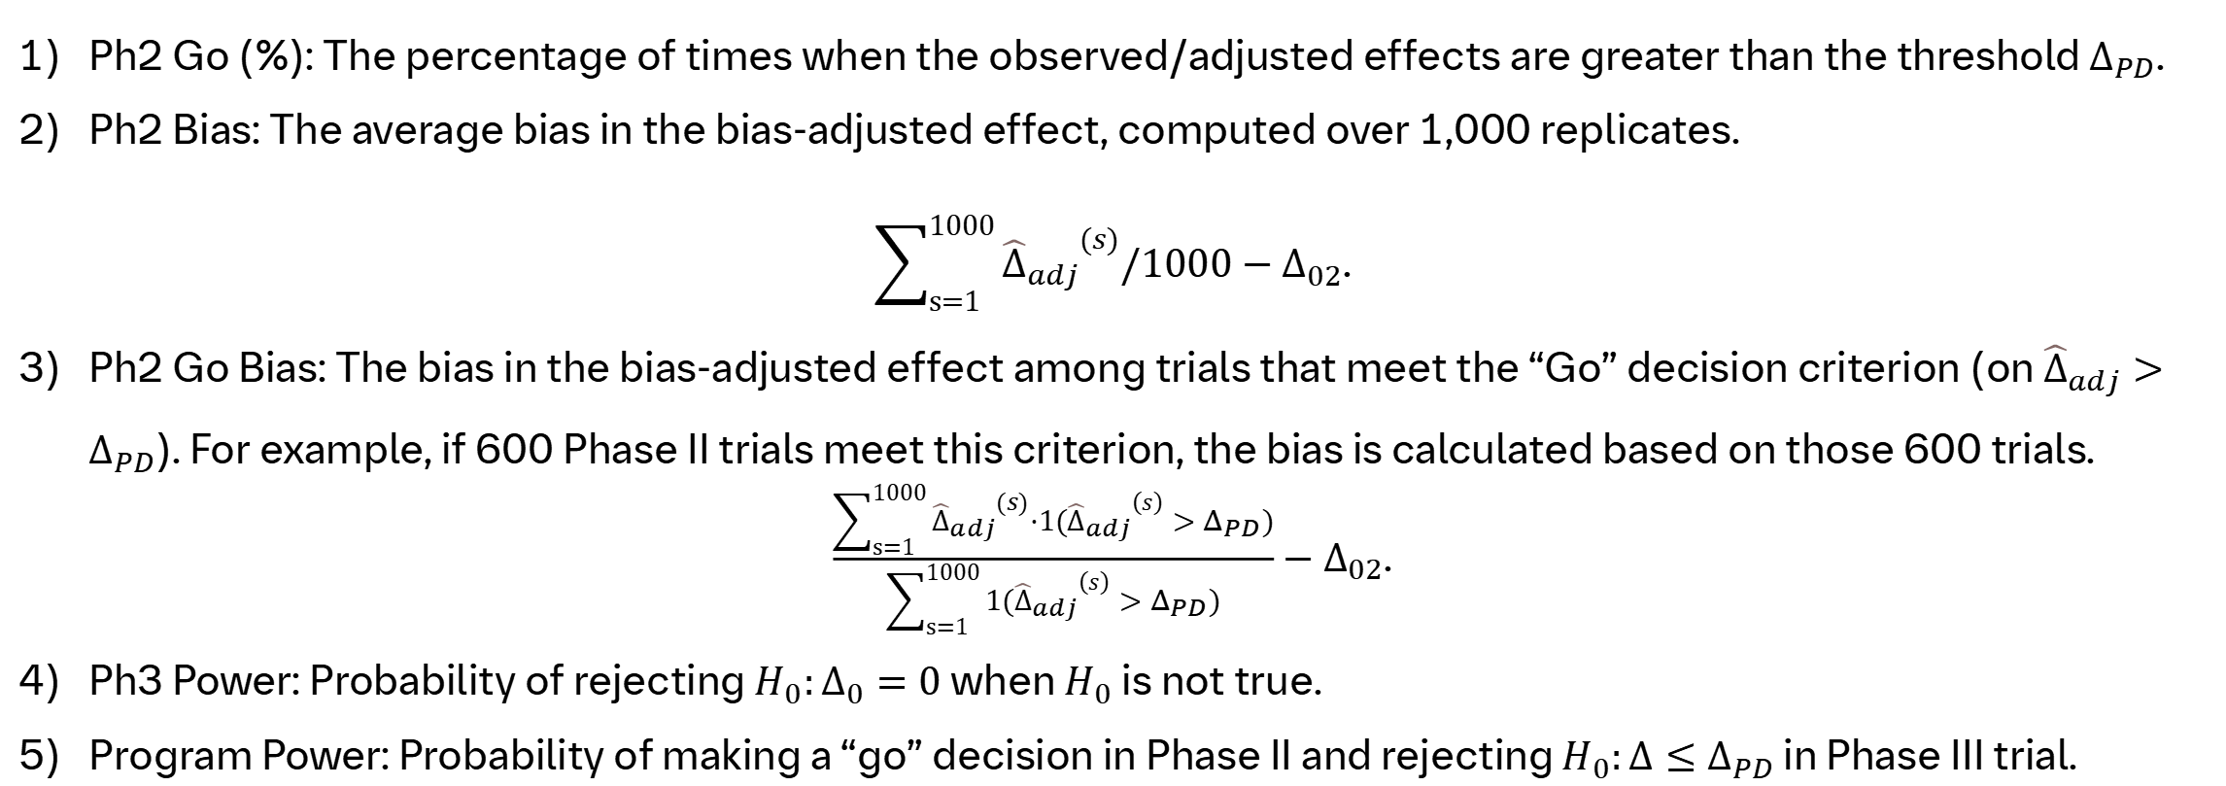
Evaluation Metrics
Ph2 Go (%): The percentage of times when the observed/adjusted effects are greater than the threshold $Δ_{PD}$.
Ph2 Bias: The average bias in the bias-adjusted effect, computed over 1,000 replicates.
$\sum_{s=1}^{1000}{{{\hat{Δ}}_{adj}}^{(s)}}/1000−Δ_{02}$.
Ph2 Go Bias: The bias in the bias-adjusted effect among trials that meet the “Go” decision criterion (on ${\hat{Δ}}_{adj}>Δ_{PD}$). For example, if 600 Phase II trials meet this criterion, the bias is calculated based on those 600 trials.
$\frac{\sum_{s=1}^{1000}{{{\hat{Δ}}_{adj}}^{(s)}·1({{\hat{Δ}}_{adj}}^{\left(s\right)}>Δ_{PD})}}{\sum_{s=1}^{1000}{1({{\hat{Δ}}_{adj}}^{\left(s\right)}>Δ_{PD})}}$ $−Δ_{02}$.
Ph3 Power: Probability of rejecting $H_{0}:Δ_{0}=0$ when $H_{0}$ is not true.
Program Power: Probability of making a “go” decision in Phase II and rejecting $H_{0}:Δ≤Δ_{PD}$ in Phase III trial.
Notes:
Ph2 bias is what we basically would not expect an unadjusted effect change. It should be near 0. and bias adjustment method is hoped to shrink back to smaller.

Slide 19
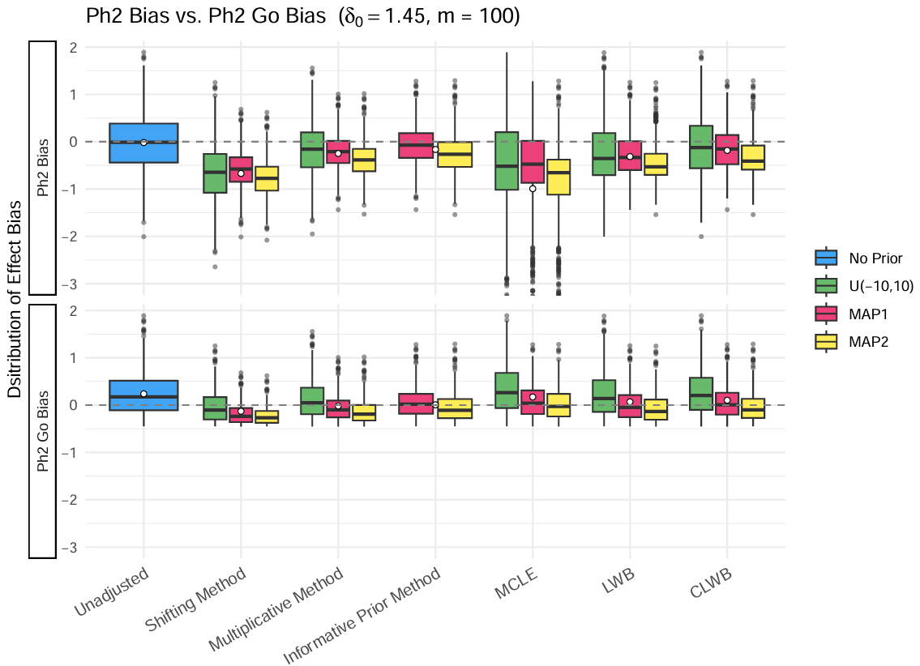
Phase II Effect Bias: positive scenario
Results
Adjustments generally move in the right direction and incorporating historical data leads to greater adjustments with reduced variability.
However, definitive conclusions are challenging because results depend on how the historical data are shifted.
Note: MCLE groups have extreme negative outliers below -3 in the top panel, which are not shown.
Notes:
We only display the bias boxplots for positive scenario due to the amount of time.
Negative scenario always induces bias and estimation bias is not the key metric in this case. The false-go operating characteristics are more meaningful. (False positive for negative scenario)

Slide 20
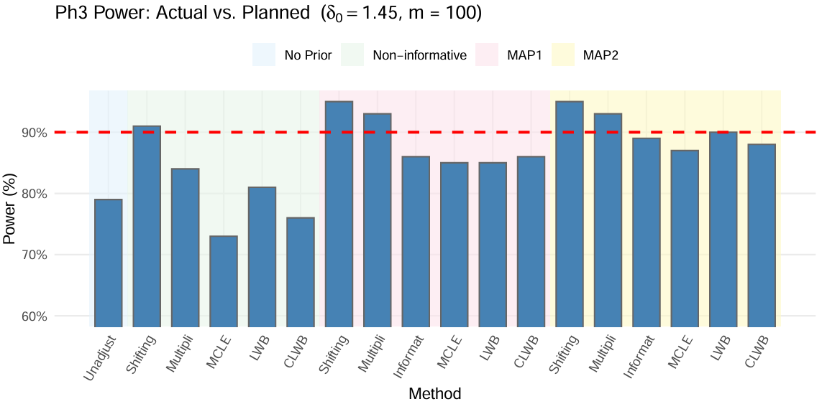
Phase III Power: positive scenario
Results
All of the methods incorporating MAP priors performed better than unadjusted method, with shifting and multiplicative methods performing best.
Notes:
2nd plot: our delta_0 is lower than the threshold. So no matter if we adjust it to the truth, we would end up not going to Phase III. This is by design.
Tradeoff: shifting method adjusted the heaviest, which results in a higher Phase III power while we have a lot fewer Phase II trials with a “Go“ decision. That‘s why our program power is important, the joint probability of a Go decision in Phase II and a successful outcome in Phase III.

Slide 21
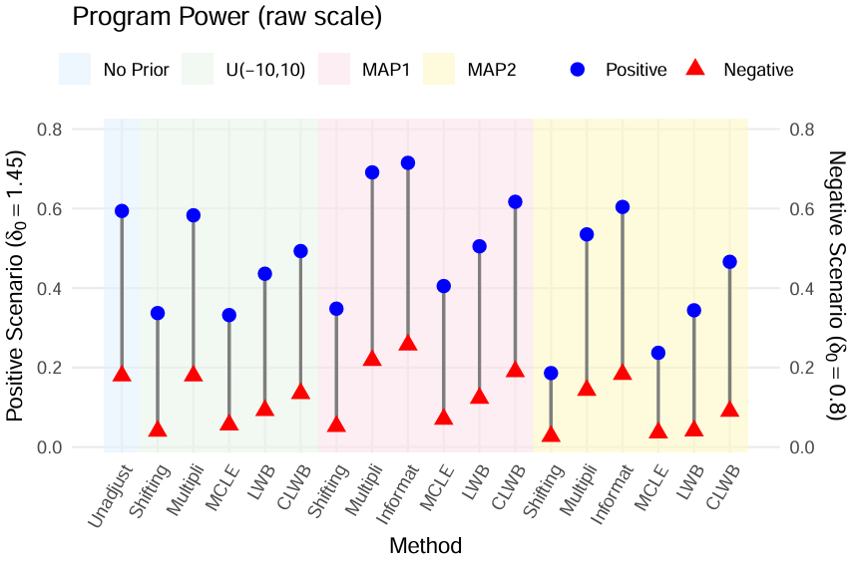
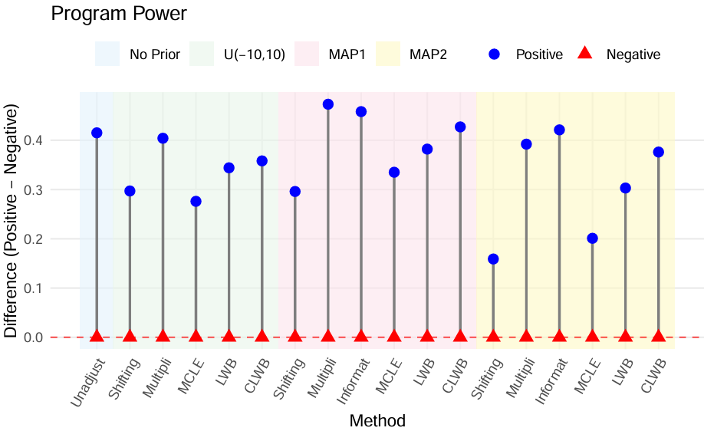
Program Power
Results
Longer segments indicate stronger discrimination between positive and negative scenarios, i.e., better decision-making.
Notes:
1st plot: some of these methods are going to adjust the bias more and that‘s going to result in a lower false positive, i.e., the negative scenario results. But accordingly, just because the way things work, we end up getting a lower true positive go rate. People could tune the decision rules toward their target program power, like how much false-positive rate they want.
2nd plot: But for a fair comparision, we switch to the right plot, which calculates the difference in program power between positive and negative scenarios. The discrmination ability is the fifference between the two scenarios. MAP1 is our optimistic prior.
That‘s not hurting us very much in the false positive when using a negative prior.
Takeaways:
The bias subtraction methods, like CLWB seems to be doing pretty well, whereas like the likelihood weighted bias which doesn‘t use truncated normal distribution doesn‘t do well.
Some methods, they are doing worse than unadjusted method.

Slide 22
Conclusions
No single method is a “magic bullet”. Results depend on the prior-data conflict and there are tradeoffs between Phase III power and Phase II Go (%). The bias adjustment methods help improve the robustness, but no single method is universally optimal.
Simulations need to be tailored for each individual study. The results are specific to the current study design and pseudo-historical data we used. Different projects will have different designs, data structure, and decision rules, so the operating characteristics will change.
Further methodological development is needed. Our method derives the expected Phase III power conditional on the observed Phase II effect size by using the truncated normal likelihood and a prior distribution. It accounts for selection bias by increasing the sample size needed for Phase III.
Notes:
Our key point is that everything shown here is specific to this particular design and the historical data assumption we used. If the design or data change, the operating characteristics will change as well. That’s why we need to run simulations tailored to each study rather than applying one set of results across different projects.
For example, we want to optimize our study design to target a false-positive rate of 20% and I want to make sure every single method does that. We can play with other parameters, like decision rules, sample sizes for each method to make that a fair comparison.

Slide 23
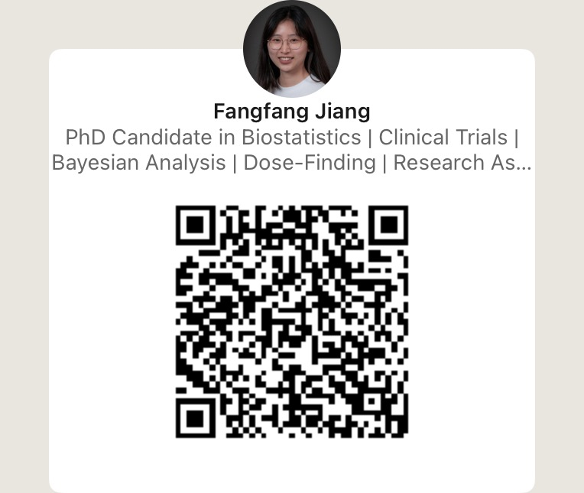
Connect on LinkedIn!
Acknowledgement
Special thanks to my mentors: Mitchell Thomann, Zhiguang (Caleb) Huo
Managers: Miguel Garcia, Mitchell Thomann
Admin Support: Joshua Pasquariello, Christian Pasquariello
HR: Deborah Storm
My fellow Co-Ops: Souvik Paul, Shiying Wu, Kimberly Palaguachi-Lopez, Konghao Zhao

Slide 24
References
[1] Chuang-Stein, C., & Kirby, S. (2021). Quantitative decisions in drug development. Springer.
[2] Wang, S. J., Hung, H. J., & O'Neill, R. T. (2006). Adapting the sample size planning of a phase III trial based on phase II data. Pharmaceutical Statistics: The Journal of Applied Statistics in the Pharmaceutical Industry, 5(2), 85-97.
[3] Kirby, S., Li, J., & Chuang‐Stein, C. (2020). Selection bias for treatments with positive Phase 2 results. Pharmaceutical statistics, 19(5), 679-691.

Slide 25
THANK YOU!
Q & A

Slide 26
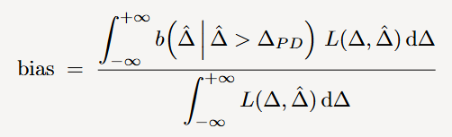
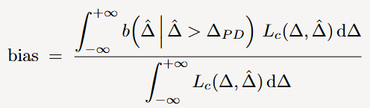
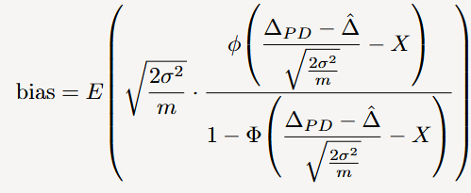
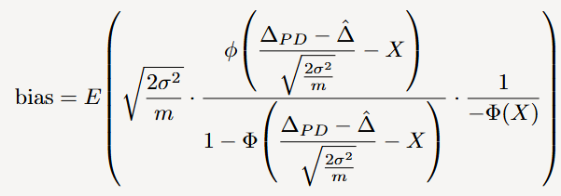


Bias Subtraction Methods
Under the condition that $\hat{Δ}>Δ_{PD}$, the bias can be expressed as
Bias-adjusted effect: $\hat{Δ}−$ bias
.
Method 6: Likelihood Weighted Bias (LWB)
Method 7: Conditional Likelihood Weighted Bias (CLWB)
Method 5: Percentile Bias (PB)
Use a Bayesian approach with a vague uniform prior for the treatment effect.
Bias = the 20% percentile of the posterior distribution.
For a normal distribution $\hat{Δ}\sim N\left(Δ,\sqrt{2{σ^{2}}/m}\right)$,
where $X \sim N(0,1)$.
For a truncated normal distribution $\hat{Δ}\sim TN\left(Δ,\sqrt{2{σ^{2}}/m}\right)$ for $\hat{Δ}>Δ_{PD}$,
where $X \sim N(0,1)$.

Slide 27
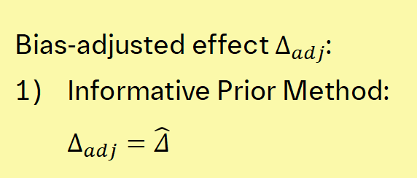
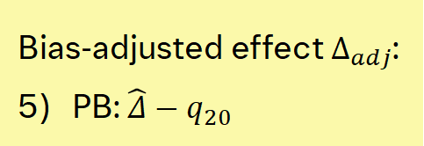
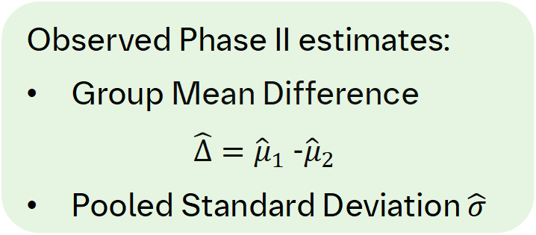
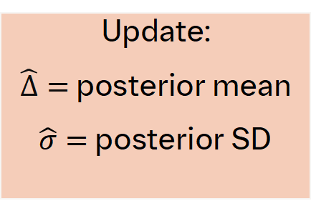
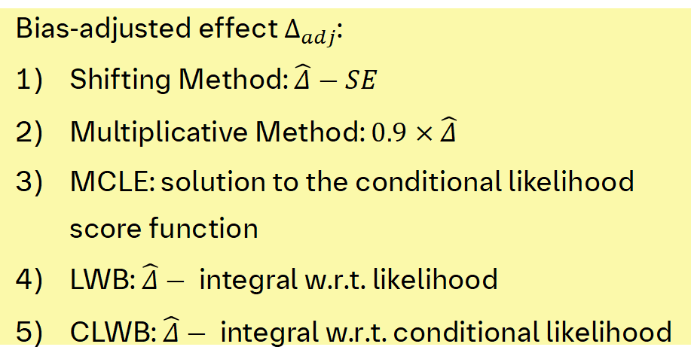
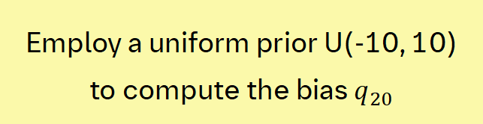
Procedure
Observed Phase II estimates:
Group Mean Difference
$\hat{Δ}={\hat{μ}}_{1}$-${\hat{μ}}_{2}$
Pooled Standard Deviation $\hat{σ}$
Including historical data?
Update:
$\hat{Δ}=$ posterior mean
$\hat{σ}=$ posterior SD
Yes
No
PB method
No
Yes
Employ a uniform prior U(-10, 10) to compute the bias $q_{20}$
Bias-adjusted effect $Δ_{adj}$:
Shifting Method: $\hat{Δ}−SE$
Multiplicative Method: $0.9×\hat{Δ}$
MCLE: solution to the conditional likelihood score function
LWB: $\hat{Δ}−$integral w.r.t. likelihood
CLWB: $\hat{Δ}−$integral w.r.t. conditional likelihood
Bias-adjusted effect $Δ_{adj}$:
Informative Prior Method: $Δ_{adj}=\hat{Δ}$
1
3
2
4
Bias-adjusted effect $Δ_{adj}$:
5) PB: $\hat{Δ}−q_{20}$
5
6
7

Slide 28
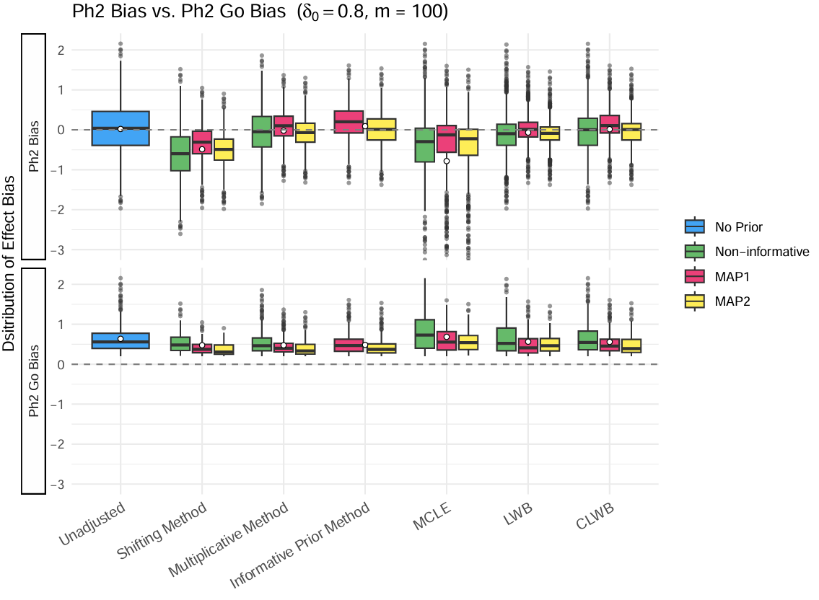
Phase II Effect Bias: negative scenario
Results
Note: MCLE groups have extreme negative outliers below -3 in the top panel, which are not shown.
Notes:
We only display the bias boxplots for positive scenario due to the amount of time.
Negative scenario always induces bias and estimation bias is not the key metric in this case. The false-go operating characteristics are more meaningful. (False positive for negative scenario)

Slide 29
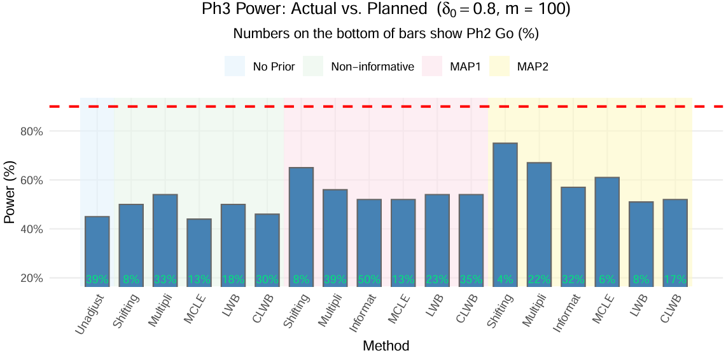
Phase III Power: negative scenario
Results
This is by design going to be underpowered.
Notes:
2nd plot: our delta_0 is lower than the threshold. So no matter if we adjust it to the truth, we would end up not going to Phase III. This is by design.

Slide 30
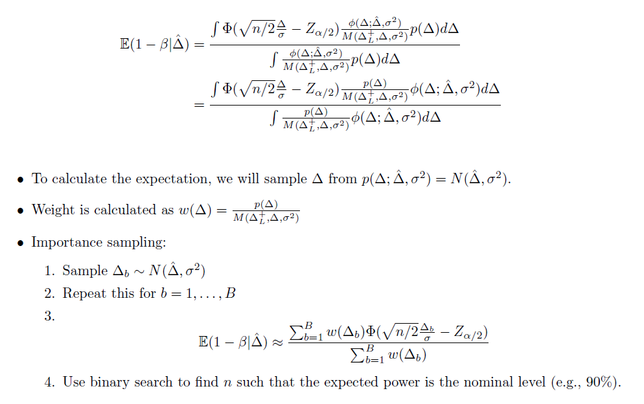
New Method

